Slide 1
LESSON 06

Slide 2
Overview
of
Previous Lesson(s)

Slide 3
Over View
Context Free Grammar is used to specify the syntax of the language.
A grammar describes the hierarchical structure of most programming language constructs.
It has components
A set of tokens (terminal symbols)
A set of nonterminals
A set of productions
A designated start symbol

Slide 4
Over View..
Given a CF grammar determining the set of all strings generated by the grammar is known as derivation.
Begin with the start symbol
In each step, replace one nonterminal in the current sentential form with one of the right-hand sides of a production for that nonterminal

Slide 5
Over View...
Parsing is the problem of taking a string of terminals and figuring out how to derive it from the start symbol of the grammar.
Given a CFG, a parse tree according to the grammar is a tree with the following properties:
The root is labeled by the start symbol.
Each leaf is labeled by a terminal or by ɛ.
Each interior node is labeled by a nonterminal.
If A → X1 X2 … Xn is a production, then node A has immediate children X1, X2, …, Xn where Xi is a (non)terminal or ε.

Slide 6
Over View…
Ambiguity: Two Parse Trees for 9 – 5 + 2
string
string
string
string
string
string
string
string
string
string
9
-
5
+
2
9
-
5
+
2

Slide 7
Over View…
Syntax-directed translation is done by attaching rules or program fragments to productions in a grammar.
An attribute is any quantity associated with a programming construct .
A translation scheme is a notation for attaching program fragments to the productions of a grammar.

Slide 8
Over View…
The postfix notation for an expression E can be defined inductively as follows:
If E is a variable or constant , then the postfix notation for E is E itself.
If E is an expression of the form El op E2 , where op is any binary operator, then the postfix notation for E is E₁’ E₂’ op, where E₁’ and E₂’ are the postfix notations for El and E2 , respectively.
If E is a parenthesized expression of the form (E1), then the postfix notation for E is the same as the postfix notation for E1.

Slide 9
Over View…
Ex (9 - 5) + 2
Translations of 9, 5 and 2 are constant themselves by Rule 1
9 – 5 is 95- by Rule 2
(9-5) is the same by Rule 3
Now we have to apply Rule 2
So E₁ represents (9-5) , E₂ represents 2 , op is +
We got 95-2+ by Rule 2

Slide 10
Over View…
A syntax-directed definition associates
With each grammar symbol, a set of attributes, and
With each production, a set of semantic rules for computing the values of the attributes associated with the symbols appearing in the production.
A parse tree showing the attribute values at each node is called an annotated parse tree.

Slide 11
Over View…
An attribute is said to be synthesized if its value at a parse-tree node N is determined from attribute values at the children of N and at N itself.
Tree traversals are used for describing attribute evaluation and for specifying the execution of code fragments in a translation scheme.
A syntax-directed translation scheme is a notation for specifying a translation by attaching program fragments to productions in a grammar.

Slide 12
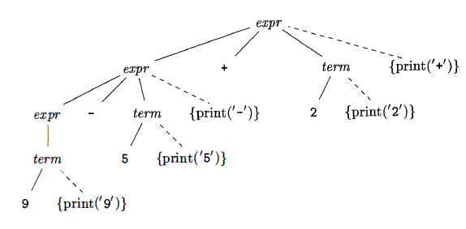
Over View…
Actions translating 9-5+2 into 95-2+

Slide 13
TODAY’S LESSON

Slide 14
Contents
DF Traversal
Parsing
Top Down Parsing
Predictive Parsing
E-Productions
Designing a Predictive Parser
Left Recursion

Slide 15
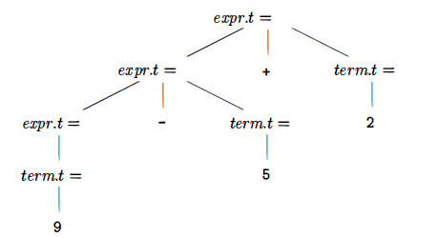
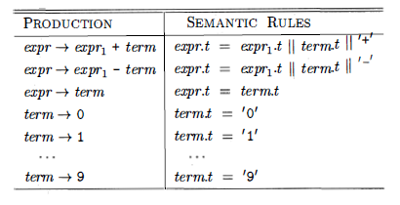
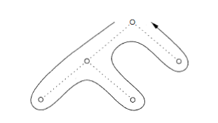
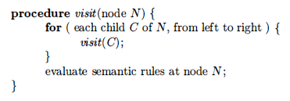
DF Traversal
DF Traversal

Slide 16
Parsing
Parsing is the process of determining if and how a string of terminals can be generated by a grammar.
A parser takes at most O (n³) time to parse a string of n terminals.
Most parsing methods fall in following classes:
Top Down Parsing
In top-down parsers, construction starts at the root and proceeds towards the leaves
Bottom Up Parsing
In bottom-up parsers, construction starts at the leaves and proceeds towards the root.

Slide 17
Top Down Parsing
The top-down construction of a parse tree is done by starting with the root, labeled with the starting non terminal stmt, and repeatedly performing the following two steps:
At node N, labeled with non terminal A, select one of the productions for A and construct children at N for the symbols in the production body.
Find the next node at which a subtree is to be constructed, typically the leftmost unexpanded nonterminal of the tree.

Slide 18
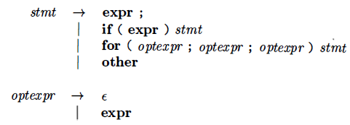
Top Down Parsing..
The current terminal being scanned in the input is known as the lookahead symbol.
Initially, it is the first, i.e., leftmost, terminal of the input string.
Ex. Grammar

Slide 19
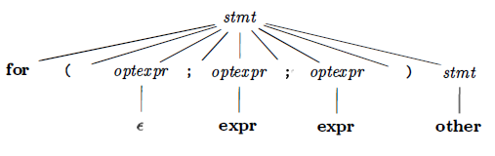
Top Down Parsing...
Parse tree for our example grammar.

Slide 20
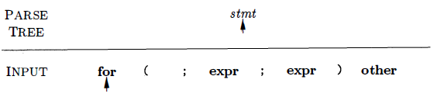
Top Down Parsing...
Step by step construction of the parse tree for the following input string.
for ( ; expr ; expr ) other
In start, the terminal for is the lookahead symbol, and the known part of the parse tree is the root labeled stmt

Slide 21
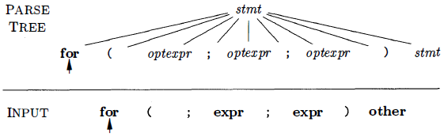
Top Down Parsing...
For a match to occur, the non terminal stmt must derive a string that starts with the lookahead symbol for .
Selecting the relevant production from grammar and construct the children of the root labeled with the symbols in the production body as follows.

Slide 22
Top Down Parsing...
For a match to occur, the non terminal stmt must derive a string that starts with the lookahead symbol for
Selecting the relevant production & construct the children of the root labeled with the symbols in the production body as follows.
Production used: stmt - > for (optexpr ; optexpr ; optexpr ) stmt

Slide 23
Top Down Parsing...
Now the children have just been constructed at the root , and the leftmost child labeled with for is being considered.
When the node being considered in the parse tree is for a terminal, and the terminal matches the lookahead symbol, then we advance in both the parse tree and the input.
The next terminal in the input becomes the new lookahead symbol, and the next child in the parse tree is considered.

Slide 24
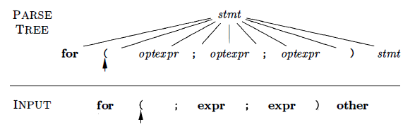
Top Down Parsing...
Now the arrow in the parse tree has advanced to the next child of the root , and the arrow in the input has advanced to the next terminal, which is (
A further advance will take the arrow in the parse tree to the child labeled with non terminal optexpr and take the arrow in the input to the terminal ;

Slide 25
Top Down Parsing...
Now for the non terminal node labeled optexpr, repeat the process of selecting a production.
Production used: optexpr - > ɛ
In this way more productions are selected in the following order to construct the parse tree.
optexpr - > ɛ
optexpr - > ɛ
stmt - > other

Slide 26
Predictive Parsing
Recursive-descent parsing is a top-down method of syntax analysis.
Each non terminal has one (recursive) procedure that is responsible for parsing the non terminals.
When a non terminal has multiple productions, each production is implemented in a branch of a selection statement based on input look-ahead information.
A recursive-descent parsing, in which the lookahead symbol unambiguously determines the flow of control through the procedure body for each non terminal is called predictive parsing.

Slide 27
Predictive Parsing..
Lets see an example.
Grammar
type → simple | ^ id | array [ simple ] of type
simple → integer | char | num dotdot num

Slide 28
Predictive Parsing...
procedure type(); begin if lookahead in { ‘integer’, ‘char’, ‘num’ } then simple() else if lookahead = ‘^’ then match(‘^’); match(id) else if lookahead = ‘array’ then match(‘array’); match(‘[‘); simple(); match(‘]’); match(‘of’); type() else error() end;
procedure match(t : token); begin if lookahead = t then lookahead := nexttoken() else error() end;
procedure simple(); begin if lookahead = ‘integer’ then match(‘integer’) else if lookahead = ‘char’ then match(‘char’) else if lookahead = ‘num’ then match(‘num’); match(‘dotdot’); match(‘num’) else error() end;

Slide 29
Predictive Parsing...
The predictive parser consists of procedures for the non terminals type and simple of the grammar.
Procedure match(t:token) compares its argument t with the lookahead symbol and advances to the next input terminal if they match. Thus match changes the value of variable.
Parsing begins with a call of the procedure type() for the starting non terminal.

Slide 30
Predictive Parsing...
Step 01
type()
Check lookahead and call match
match(‘array’)
Input:
array
[
num
dotdot
num
]
of
integer
lookahead

Slide 31
Predictive Parsing...
Step 02
type()
match(‘array’)
match(‘[’)
Input:
array
[
num
dotdot
num
]
of
integer
lookahead

Slide 32
Predictive Parsing...
Step 03
type()
match(‘array’)
match(‘[’)
simple()
match(‘num’)
Input:
array
[
num
dotdot
num
]
of
integer
lookahead

Slide 33
Predictive Parsing...
Step 04
type()
match(‘array’)
match(‘[’)
simple()
match(‘num’)
match(‘dotdot’)
Input:
array
[
num
dotdot
num
]
of
integer
lookahead

Slide 34
Predictive Parsing...
Step 05
type()
match(‘array’)
match(‘[’)
simple()
match(‘num’)
match(‘dotdot’)
match(‘num’)
Input:
array
[
num
dotdot
num
]
of
integer
lookahead

Slide 35
Predictive Parsing...
Step 06
type()
match(‘array’)
match(‘[’)
simple()
match(‘]’)
match(‘num’)
match(‘dotdot’)
match(‘num’)
Input:
array
[
num
dotdot
num
]
of
integer
lookahead

Slide 36
Predictive Parsing...
Step 07
type()
match(‘array’)
match(‘[’)
simple()
match(‘]’)
match(‘of’)
match(‘num’)
match(‘dotdot’)
match(‘num’)
Input:
array
[
num
dotdot
num
]
of
integer
lookahead

Slide 37
Predictive Parsing...
Step 08
type()
match(‘array’)
match(‘[’)
simple()
match(‘]’)
match(‘of’)
type()
simple()
match(‘num’)
match(‘dotdot’)
match(‘num’)
match(‘integer’)
Input:
array
[
num
dotdot
num
]
of
integer
lookahead

Slide 38
ɛ Productions
Predictive parser uses an ɛ production as a default when no other production can be used.

Slide 39
Designing a Predictive Parser
FIRST(α) is the set of terminals that appear as the first symbols of one or more strings generated from α
type → simple
| ^ id
| array [ simple ] of type simple → integer
| char
| num dotdot num
FIRST(simple) = { integer, char, num } FIRST(^ id) = { ^ }
FIRST(type) = { integer, char, num, ^, array }

Slide 40
Designing a Predictive Parser..
We use FIRST to write a predictive parser as follows
When a nonterminal A has two (or more) productions as in
A → α | β
Then FIRST (α) and FIRST(β) must be disjoint for predictive parsing to work
procedure rest(); begin if lookahead in FIRST(+ term rest) then match(‘+’); term(); rest() else if lookahead in FIRST(- term rest) then match(‘-’); term(); rest() else return end;
expr → term rest rest → + term rest | - term rest | ε

Slide 41
Left Recursion
When a production for non terminal A starts with a self reference then a predictive parser stuck in loop forever.
i.e A - > A α | β
α & β are sequences of terminals and non terminals that do not start with A.
A left-recursive production can be eliminated by systematically rewriting the grammar using right recursive productions
A - > β R | α R
R - > α R | ɛ

Slide 42
Thank You

